Slide 1

The Final Push
Python • Pandas
HTML/CSS/BootStrap •Leaflet
JavaScrip •Flask

Slide 2

Machine Learning Final Project
By:
Kevin Athey
Benjamin Raehpur
Ricardo Dominguez
Aaron Schwartzmzn
Grecia Acosta

Slide 3
All about Linguistics
Overview or Background:
Linguistics background
Availability of typological dataset at Wals

Slide 4

Hypothesis: Is it possible to predict the likely location of a language from its characteristics?
Notes:
Consider talking about:
Machine learning tasks

Slide 5

The process
Notes:
Consider talking about:
Types of learning algorithms
Models
Training models

Slide 6

Data Data Data!
The World Atlas of Language Structures (WALS) is a large database of structural (phonological, grammatical, lexical) properties of languages gathered from descriptive materials (such as reference grammars) by a team of 55 authors.
https://wals.info/feature

Slide 7
Data Cleaning Scrapping (Tap Separated Dataset)
Load Dataset
• We used pandas to load the data. We also used pandas to explore the data visualization.
Data exploration
• What surprises each dataset holds? (192 Datasets Total )
Data cleansing
• Eliminate errors that muddy the waters . Removed all the columns that didn't need for our prediction.
Data blending
• Join multiple datasets (The tricky part)
Data profiling
• Convert data to numerical
Summarize the Data
• Make data digestible for our model.

Slide 8
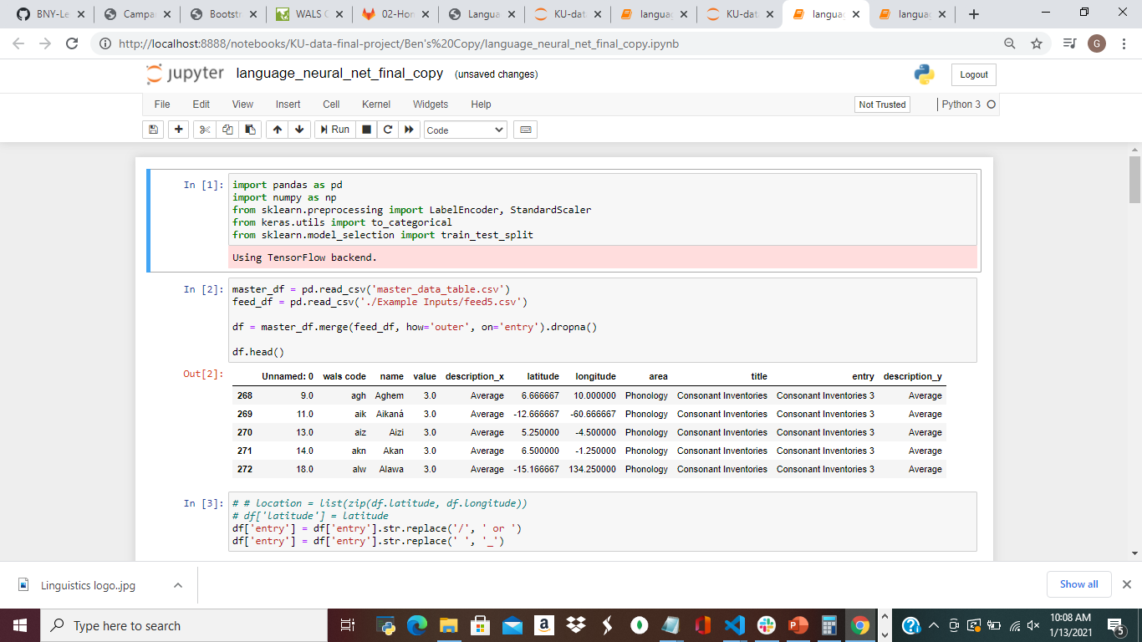
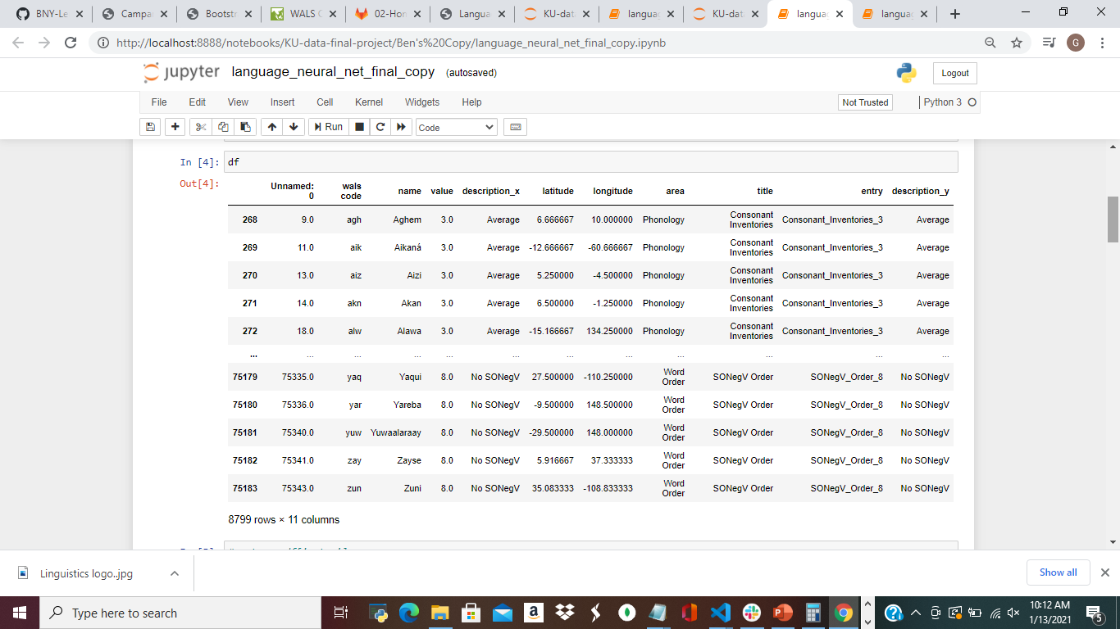
Machine Learning
Machine Learning Process
•
•

Slide 9
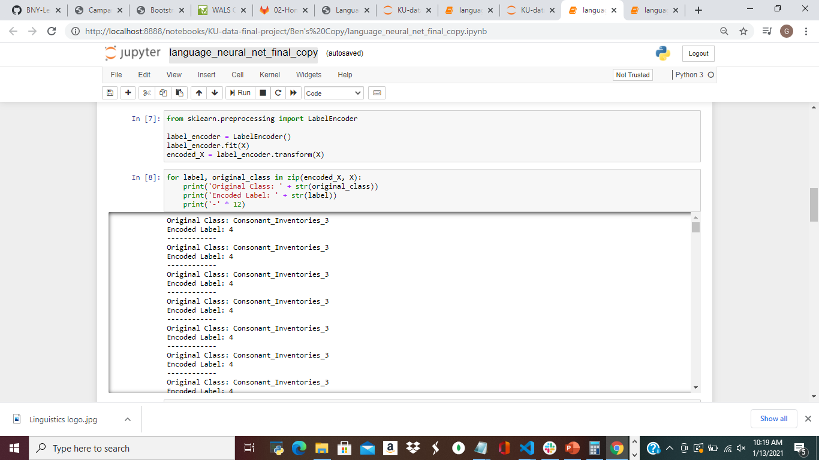
Machine Learning
Machine Learning Process
•
•

Slide 10
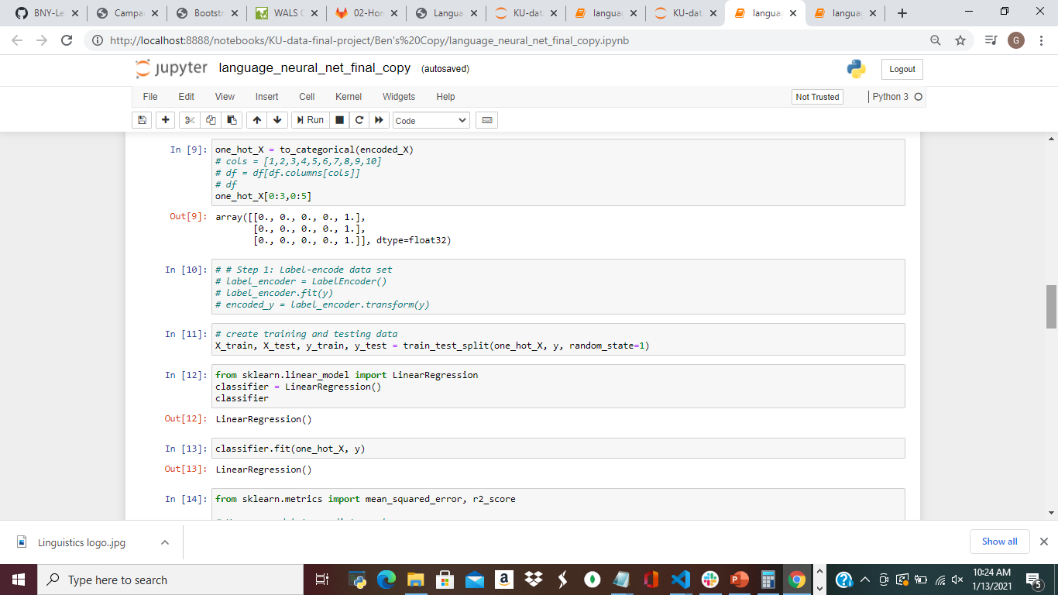
Machine Learning
Machine Learning Process
•
•

Slide 11
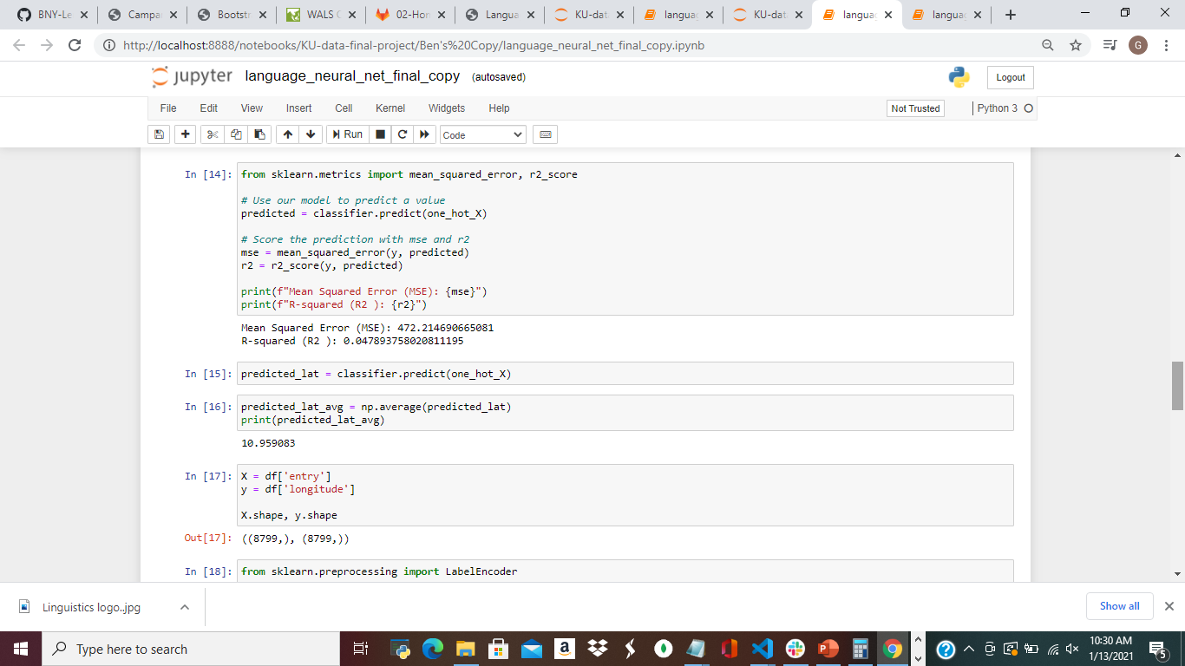
Machine Learning
Machine Learning Process
•
•

Slide 12
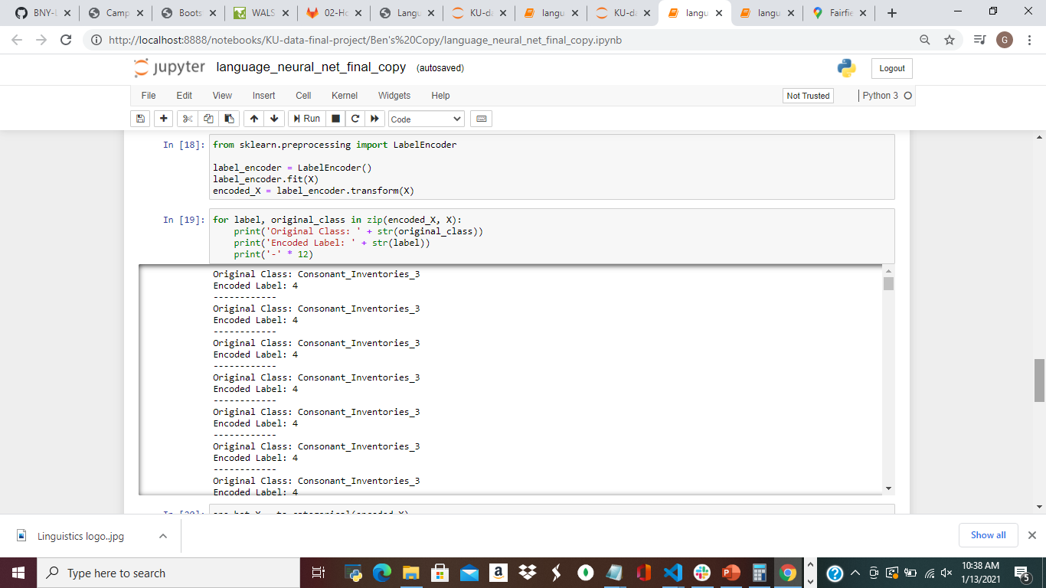
Machine Learning
Machine Learning Process
•
•

Slide 13
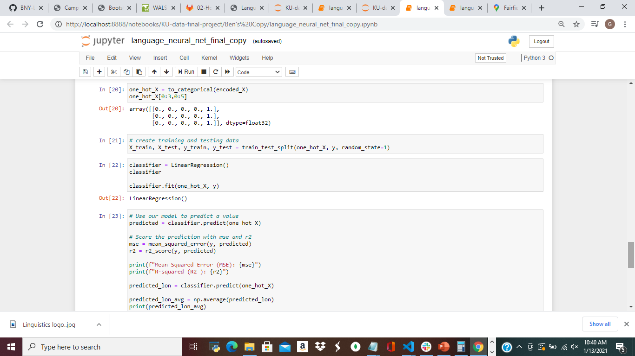
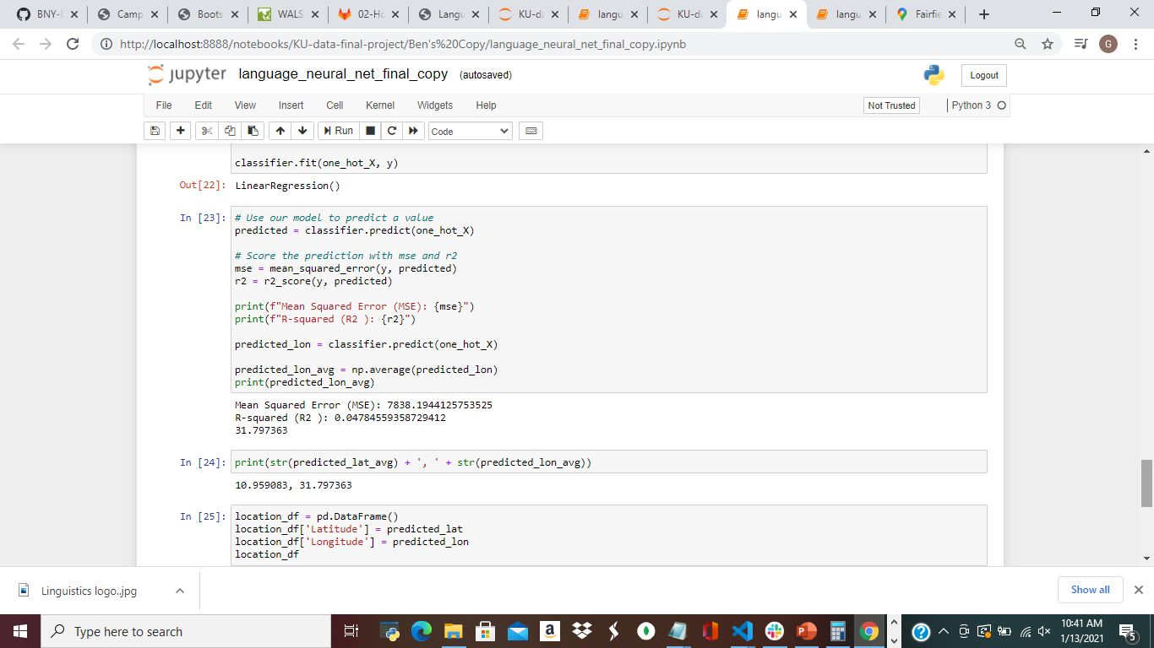
Machine Learning
Machine Learning Process
•
•

Slide 14
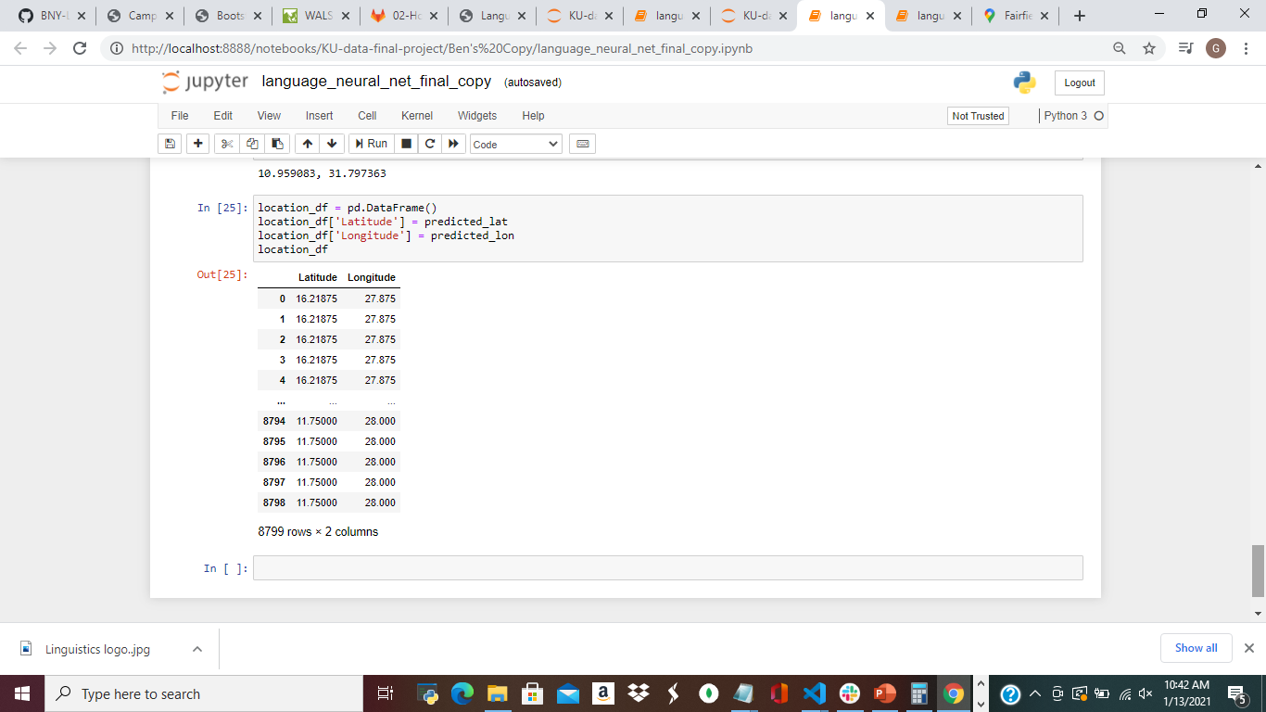
Machine Learning
Machine Learning Process
•
•

Slide 15
Heatmapping
Heatmapping Process (Kevin)

Slide 16
Let’s Visualize!!
Notes:
Consider talking about:
Relation to data mining
Relation to optimization
Relation to statistics

Slide 17
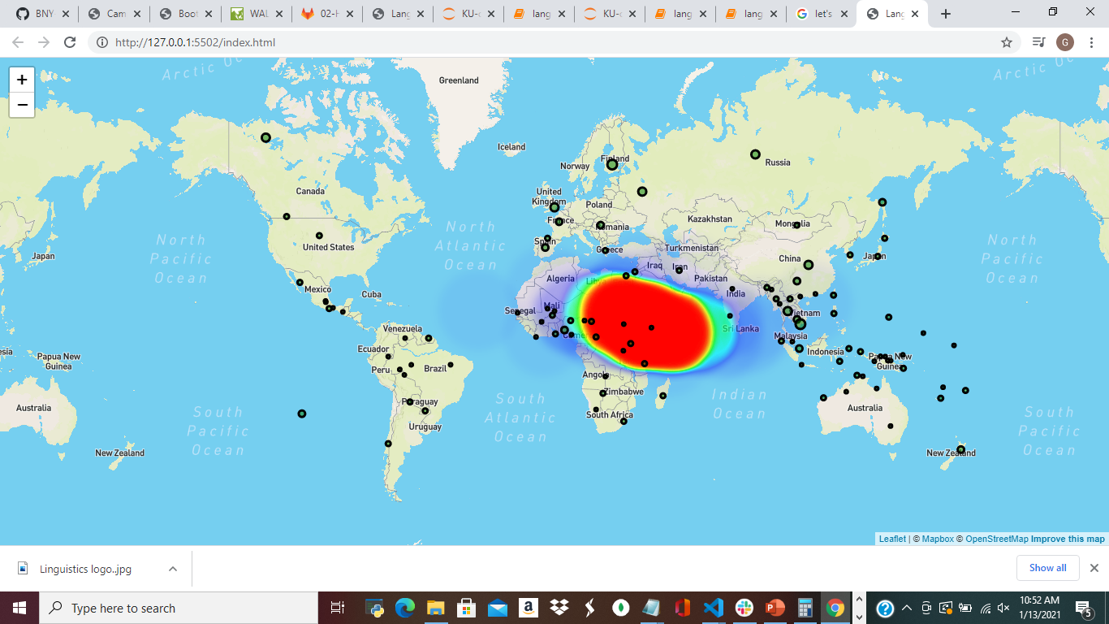
What is the map telling us?
Key point
Key point
Key Point

Slide 18
What is the map telling us?
Key point
Key point
Key Point

Slide 19
What is the map telling us?
Key point
Key point
Key Point

Slide 20
The take-away
Conclusion:
We can’t predict a language base on its characteristics.

Slide 21
Possible Future Functionality
User-friendly interface
More correlational Data

Slide 22
Thank you

